Slide 1
Business Communication, 11e
Chapter 2: Professionalism: Team, Meeting, Listening, Nonverbal, and Etiquette Skills
Guffey/Loewy, Business Communication: Process & Product, 11th Edition. © 2025 Cengage Learning, Inc. All Rights Reserved. May not be scanned, copied or duplicated, or posted to a publicly accessible website, in whole or in part.

Slide 2
Chapter Objectives
By the end of this chapter, you should be able to:
2.1 Explain how you can contribute to successful team performance in the digital-age workplace.
2.2 Identify best practices for effective face-to-face and virtual meetings.
2.3 Name active listening skills.
2.4 Discuss how effective nonverbal communication can help you advance your career.
2.5 Describe how developing professionalism and business etiquette skills can give you a competitive edge.

Slide 3
Learning Objective 2.1
Explain how you can contribute to successful team performance in the digital-age workplace.

Slide 4
Succeeding in Professional Teams (1 of 9)
Getting Noticed by Digital-Age Employers
Hard skills* – technical expertise in a worker’s field
Soft skills* – interpersonal or social skills or, more broadly, emotional intelligence
Desirable competencies – oral and written communication skills, active listening skills, appropriate nonverbal behavior, and proper business etiquette
Matrixed teams* – job tasks are spread out across multiple teams
* Words accompanied by an asterisk are key terms from the chapter.
Notes:
Social skills are immensely important, not only to be hired but also to be promoted.
Long-term success depends on effective communication with your boss, coworkers, and customers.
“The talent gap in soft digital skills is more pronounced than in hard digital skills.”

Slide 5
Succeeding in Professional Teams (2 of 9)
Understanding the Purpose of Teams
Teams are formed for the following reasons:
Better decisions
Faster responses
Increased productivity
Greater buy-in
Less resistance to change
Improved employee morale
Reduced risks
Knowledge and information workers who struggle to set boundaries may experience collaborative overload*, where constant interaction inflates their workload, they fall behind, and their performance suffers.
Notes:
You will likely find yourself a part of a work team, project team, customer support team, supplier team, design team, planning team, functional team, cross-functional team, or some other group.
One of the most important objectives of businesses is finding ways to do jobs better at less cost.
Organizations must strike a balance between solo effort and collective action.

Slide 6
Succeeding in Professional Teams (3 of 9)
Working Remotely: The Rise of Virtual Teams
Virtual teams* – remote collaborations with a group of dispersed people who, aided by communication technology, must accomplish shared tasks without face-to-face contact across geographic boundaries
Technology allows connection of facilities around the globe, wherever talent resides.
Today, work is what one does, rather than a place one goes.
Virtual teams benefit from shared views, a mix of skills, and diversity.

Slide 7
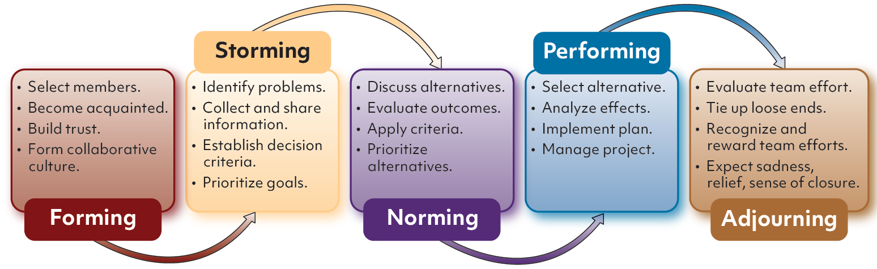
Figure 2.1 Five Phases of Team Development in Decision-Making
Notes:
Figure 2.1 outlines the five phases of team development and how a team might proceed through these steps to solve a problem and reach a decision.
Forming
Storming
Norming
Performing
Adjourning

Slide 8
Figure 2.2 Positive and Negative Group Behaviors
Positive Group Behaviors
Setting rules and abiding by them
Analyzing tasks and defining problems
Contributing information and ideas
Showing interest by listening actively
Encouraging members to participate
Negative Group Behaviors
Blocking the ideas of others
Insulting and criticizing others
Making improper jokes and comments
Failing to stay on task
Withdrawing, failing to participate
Notes:
To be a productive and welcome member of a group, be prepared to perform the positive tasks described in Figure 2.2 and avoid the negative behaviors.

Slide 9
Succeeding in Professional Teams (4 of 9)
Preventing Groupthink
Groupthink* – faulty decision-making processes by team members who are overly eager to agree with one another
Successful teams use productive conflict, listening, and debate to arrive at the right answer.
Groupthink results from members with similar backgrounds, lack of procedure, demands for a quick decision, and/or a leader who favors a specific outcome.
Avoid groupthink through team diversity, open discussion, evaluation of alternative solutions, and contingency planning.
Notes:
Symptoms of groupthink include pressure placed on any member who argues against the group’s mutual beliefs, self-censorship of thoughts that stray from the group’s agreement, collective efforts to rationalize, and an unquestioned belief in the group’s moral authority.

Slide 10
Succeeding in Professional Teams (5 of 9)
Reaching Group Decisions
Majority: Majority wins via vote; leads to alienation and lack of commitment
Consensus: Team members ultimately agree through discussion; time consuming, but results in commitment to implementation
Minority: Subcommittee investigates and makes recommendation; saves time
Averaging: Middle position reached through negotiation and compromise; most knowledgeable opinions may be lost
Authority rule with discussion: Leader listens to team ideas and decides
Notes:
The method teams use to reach decisions greatly affects morale, commitment, and implementation success.
In addition to “majority rules,” these other methods may be more effective.
Some methods are best for routine decisions, while others are more appropriate when dealing with emergencies.

Slide 11
Succeeding in Professional Teams (6 of 9)
Identifying Successful Teams
Stay Small and Embrace Diversity
Teams with fewer than ten members tend to be more cohesive, with four to six members being optimal for most projects.
Diversity in age, ethnicity, social background, training, and experience is key.
Agree on a Purpose
An effective team begins with a purpose and then works toward specific goals.
Notes:
TEAM: Together, Everyone Achieves More.
Teams that do not work well together can increase frustration, lower productivity, and create employee dissatisfaction.
Effective teams share some or all of the following characteristics:
Stay small and embrace diversity
Agree on a purpose
Establish procedures
Confront conflict
Communicate effectively
Collaborate rather than compete
Accept ethical responsibilities
Share leadership

Slide 12
Succeeding in Professional Teams (7 of 9)
Establish Procedures
Develop guiding procedures, set intermediate goals with deadlines, assign roles and tasks, and decide how to make decisions.
Continually evaluate procedures to ensure movement toward the goal.
Confront Conflict
Acknowledge conflict and address the root of the problem openly.
Focus on strengths and weaknesses of positions and ideas, not personalities.

Slide 13
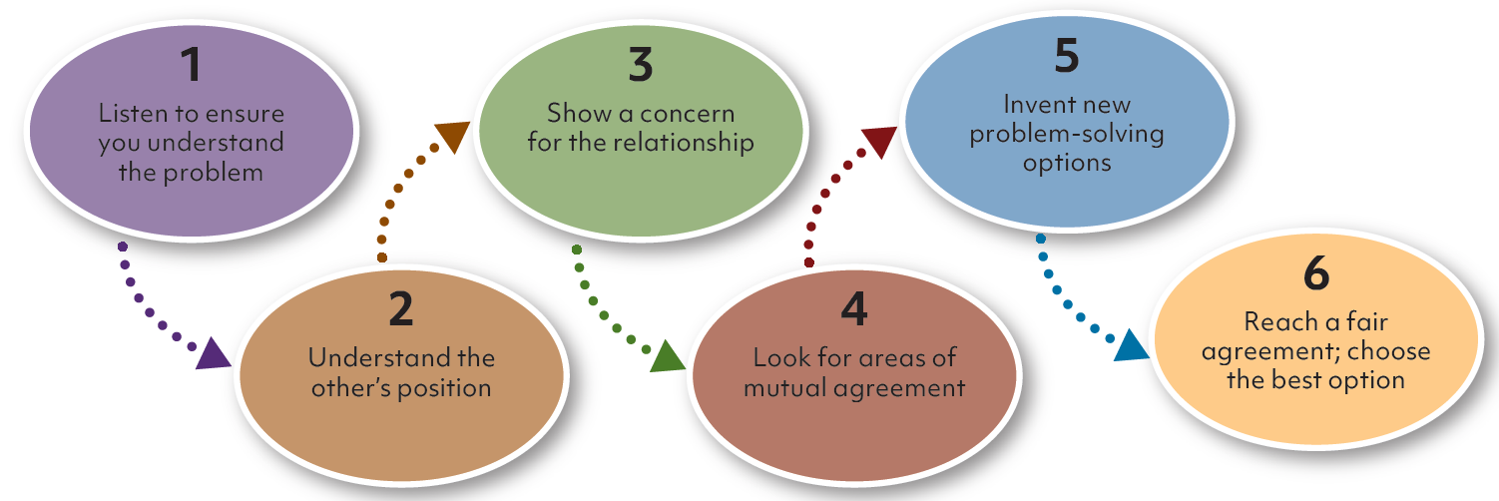
Figure 2.3 Six Steps for Dealing With Conflict
Notes:
Using the six-step plan for dealing with conflict illustrated in Figure 2.3 can save time and enhance team commitment.

Slide 14
Succeeding in Professional Teams (8 of 9)
Communicate Effectively
Use technology to facilitate an informal environment for free information exchange.
Be concise and clear; avoid generalities; ask clarifying questions.
Encourage feedback and be an active listener; inject humor in interactions.
Collaborate Rather Than Compete
Focus on team goal achievement and not individual recognition.
Monitor progress: What’s going right? What’s going wrong? What to do about it?

Slide 15
Succeeding in Professional Teams (9 of 9)
Accept Ethical Responsibilities
Represent the organization’s view.
Respect privileged information.
Avoid advocating actions that would endanger members of society.
Share Leadership
Rotate leadership according to appropriate expertise as a project evolves.
Ensure there’s a strong team member to step up as leader in a crisis.

Slide 16
Learning Objective 2.2
Identify best practices for effective face-to-face and virtual meetings.

Slide 17
Making the Most of Face-to-Face and Virtual Meetings (1 of 10)
Contributing in Face-to-Face Meetings
View meetings as opportunities to demonstrate leadership, communication, and problem-solving skills.
Focus on making meetings efficient, satisfying, and productive.
Face-to-face meeting provides nonverbal cues and signals, making it the richest of available media.
Notes:
Business meetings consist of three or more people who gather to share information, solicit feedback, clarify policy, seek consensus, and solve problems.
Research indicates that the average worker spends 3 hours a week in meetings and 92% of employees consider meetings unproductive and costly.
The real expense of a meeting is the lost productivity of the people attending.

Slide 18
Making the Most of Face-to-Face and Virtual Meetings (2 of 10)
Preparing for the Meeting
Determining the Purpose of the Meeting
Consult the key people who will be attending.
Ask them what outcomes they desire and how to achieve those goals.
Selecting Meeting Participants
The meeting purpose determines the number of participants.
For decision making, limit participant count to between four and eight.
Inviting key stakeholders who represent various interests, perspectives, and competencies ensures valuable input and, therefore, is more likely to lead to informed decisions.

Slide 19
Making the Most of Face-to-Face and Virtual Meetings (3 of 10)
Using Digital Calendars to Schedule Meetings
Google Calendar, Apple Calendar, Outlook Calendar, Doodle
Make appointments, schedule meetings, track daily activities, receive reminders
Distributing an Agenda and Other Information
Agendas and relevant information or reading materials should be distributed at least two days before a scheduled meeting.
The narrower the focus, the greater the chances for success.
Notes:
A good agenda should include the following:
Date and place of meeting
Start time and end time
Brief description of each topic, in order of priority, including names of individuals responsible for performing an action
Proposed allotment of time for each topic
Any premeeting preparation expected of participants

Slide 20
Making the Most of Face-to-Face and Virtual Meetings (4 of 10)
Managing the Meeting
Getting Started and Establishing Ground Rules
Open meetings with introduction: goal, length of meeting, background, possible solutions, constraints, agenda, and ground rules
Typical ground rules: communicate openly, be supportive, listen carefully, participate fully, confront conflict frankly, silence digital devices, and follow the agenda
Notes:
Productive leaders and participants recognize how to get the meeting started, establish ground rules, move the meeting along, and handle conflict.
Meetings should include the assignment of one attendee to take minutes and another to act as a recorder, using a projected computer screen or flipchart/whiteboard to list discussion points and agreements reached.

Slide 21
Making the Most of Face-to-Face and Virtual Meetings (5 of 10)
Moving the Meeting Along
An effective leader lets others talk and tries to involve all participants.
Use a parking lot list to avoid getting sidetracked.
Remind participants to adhere to the agenda and schedule.
When consensus is reached, summarize the position and verify agreement.
Participating Actively and Productively
Arrive early, showing respect and organization.
Come prepared and be ready with questions, comments, and good ideas.
Have a positive attitude and use positive body language.

Slide 22
Making the Most of Face-to-Face and Virtual Meetings (6 of 10)
Contribute respectfully.
Wait for others to finish, showing respect and good manners.
Keep a calm and pleasant, yet energetic voice; keep the focus on the ideas.
Give credit to others and gain allies by doing so while enhancing credibility.
Use a cell phone, tablet, and laptop only for meeting-related tasks.
Help summarize the points noted during the meeting.
Express views in the meeting, building trust. Don’t hold post-meeting sidebars that involve criticism or judgment.
Follow up, completing assignments efficiently.

Slide 23
Making the Most of Face-to-Face and Virtual Meetings (7 of 10)
Handling Conflict in Meetings
Encourage those who clash to make a complete case and question one another while other attendees listen.
Summarize what was said.
Invite comments from participants.
Consider modifications or alternatives and reach consensus as a group.

Slide 24
Making the Most of Face-to-Face and Virtual Meetings (8 of 10)
Concluding and Following Up
End meetings at the agreed-upon time or sooner.
Summarize decisions, assigned tasks, and deadlines.
Set a time for the next meeting.
Thank participants for attending.
Distribute minutes or other reports within a couple of days.
Remind participants of assignments and ensure decisions are executed.

Slide 25
Making the Most of Face-to-Face and Virtual Meetings (9 of 10)
Preparing for Virtual Meetings
Virtual meetings* – real-time gatherings of dispersed participants who connect with communication technology
The meeting management techniques discussed for face-to-face meetings prevail, but additional skills and practices are important in virtual meetings.
Select the most appropriate technology.
Ensure that all participants are able to use the technology.
Encourage participants to log in 15 minutes early.
Be aware of different time zones.

Slide 26
Making the Most of Face-to-Face and Virtual Meetings (10 of 10)
Rotate meeting times to be fair to all dispersed group members.
Decide what language to use.
Explain how questions may be asked and answered.
Ensure it is clear who is speaking in audioconferences.
Remind the group to silence all electronic alerts and alarms.
Don’t multitask.
Anticipate the limitations of virtual technology.
Manage turn-taking.
Humanize virtual meetings.

Slide 27
Learning Objective 2.3
Name active listening skills.

Slide 28
Practicing Active Listening (1 of 5)
Listening is an important leadership skill.
Good listeners make good managers.
Empathic listening*: sincerely striving to understand others’ viewpoints
Mindful*: fully present

Slide 29
Practicing Active Listening (2 of 5)
Understanding Workplace Listening
Listening to Supervisors
Don’t multitask or be distracted. Show interest, take notes, and ask questions. Avoid criticizing or arguing.
Listening to Colleagues and Teammates
Critical listening* – listen to decide whether speaker’s message is fact, fiction, or opinion
Discriminative listening* – identify main ideas, understand a logical argument, and recognize the purpose of the message

Slide 30
Practicing Active Listening (3 of 5)
Listening to Customers
Listening to customers results in increased sales and profitability and improved customer acquisition and retention.
Consumers feel better about companies that value their opinions, and smart companies hire employees who care about customers.

Slide 31
Figure 2.9 Listening to Customers: Comparing Trained and Untrained Listeners (1 of 2)
Untrained Listeners | Trained Listeners
Tune out some of what the customer is saying because they know the answer | Defer judgment; listen for the customer’s feelings and assess the situation
Focus on style; mentally dismiss grammar, voice tone, and speech mannerisms | Pay most attention to content, not to appearances, form, or other surface issues
Tend to listen mainly for facts and specific bits of information | Listen completely, trying to really understand every nuance
Attempt to take in everything being said, including exaggerations and errors (”fogging”), only to refute each comment | Listen primarily for the main idea and avoid replying to everything, especially sidetracking issues
Notes:
Figure 2.9 compares trained and untrained listeners, showing that employees trained in listening techniques are far more likely to elicit customer feedback and promote goodwill than untrained employees are.

Slide 32
Figure 2.9 Listening to Customers: Comparing Trained and Untrained Listeners (2 of 2)
Untrained Listeners | Trained Listeners
Divide their attention among two or more tasks because listening is automatic | Do one thing at a time, realizing that listening is a full-time job
Tend to become distracted by emotional words, have difficulty controlling anger | Control their anger and refuse to fight fire with fire
Interrupt the customer | Are silent for a few seconds after speakers finish to let them complete their thought
Give few, if any, verbal responses | Give affirming statements and invite additional comments
Notes:
Figure 2.9 compares trained and untrained listeners, showing that employees trained in listening techniques are far more likely to elicit customer feedback and promote goodwill than untrained employees are.

Slide 33
Practicing Active Listening (4 of 5)
Identifying Barriers to Effective Listening
Physical barriers
Psychological barriers
Language problems
Nonverbal distractions
Thought speed
Faking attention
Grandstanding
Notes:
Physical barriers – hearing disabilities, poor acoustics, noisy surroundings
Psychological barriers – tuning out a speaker whose ideas differ from ours
Language problems – unfamiliar or emotion-laden words can adversely affect listening
Nonverbal distractions – unusual clothing or speech mannerisms, body twitches, or a radical hairstyle
Thought speed – listeners can process between 400 to 800 words per minute, but speakers talk at about 125 to 175 words per minute. (The time lag can lead to daydreaming.)
Faking attention – look as if you are listening when you are not
Grandstanding – waiting politely for the next pause so that we can have our turn to speak

Slide 34
Practicing Active Listening (5 of 5)
Building Powerful Listening Skills
The following recommendations can help you improve your workplace listening effectiveness:
Stop talking.
Control the listening environment.
Listen between the lines and validate emotion.
Distinguish between facts and opinions.
Ask clarifying questions.
Paraphrase to increase understanding.
Capitalize on lag time.
Take selective notes.
Adopt an empathic, humble attitude.
Notes:
Let others talk without interrupting. Concentrate on the speaker’s words, not on your response.
Whenever possible, remove competing sounds. Choose a quiet time and place for listening. Internally, focus totally on the speaker.
Show that you are listening closely by leaning forward, nodding, and maintaining eye contact. Don’t fidget or try to complete another task at the same time you are listening.
Good listeners and critical thinkers consider whether speakers are credible and speaking within their areas of competence. They do not automatically accept assertions as facts.
Ask clarifying questions without attacking the speaker and then be quiet and listen to the answer.
Paraphrase to increase understanding by summarizing a message in your own words objectively and nonjudgmentally.
Capitalize on lag time by silently rephrasing and summarizing the speaker’s message while you wait for their next idea.
Take notes to ensure retention, making sure you have a good method for storing notes physically or digitally.
Adopt an empathic, humble attitude by trying to understand other people’s perspectives and by being open to suggestions and feedback.

Slide 35
Learning Objective 2.4
Discuss how effective nonverbal communication can help you advance your career.

Slide 36
Communicating Nonverbally (1 of 4)
Defining Nonverbal Communication
Nonverbal communication* includes all unwritten and unspoken messages, whether intended or not.
Reconciling Words and Nonverbal Cues
Nonverbal messages speak louder than words.
Effective communicators ensure nonverbal messages reinforce spoken words and professional goals.

Slide 37
Communicating Nonverbally (2 of 4)
Our Bodies Send Silent Messages
Eye Contact
Shows attention and respect and reveals sincerity, confidence, and truthfulness
Facial Expression
Be mindful of emotions displayed and how they align with intentions.
Posture and Gestures
Use good posture and mirror the person to whom you’re talking.
Be mindful of cultural differences in interpretation of posture and gestures.

Slide 38
Communicating Nonverbally (3 of 4)
Time, Space, and Territory Send Silent Messages
Time
Arrive on time for meetings and appointments, stay on task during meetings, and give ample time to appropriate projects and individuals.
Space
Use space to convey the desired environment and objectives.
Territory
Be aware of others’ zones of privacy as defined by Edward T. Hall
Intimate (1–1.5 feet), personal (1.5–4 feet), social (4–12 feet), and public (12 or more feet)

Slide 39
Communicating Nonverbally (4 of 4)
Appearance Sends Silent Messages
Eye Appeal of Business Documents
Avoid sloppy communication and use the appropriate appearance and format to convey the message.
Personal Appearance
Viewers judge status, credibility, personality, and potential based upon personal appearance.
Invest in appropriate, professional-looking clothing and accessories.

Slide 40
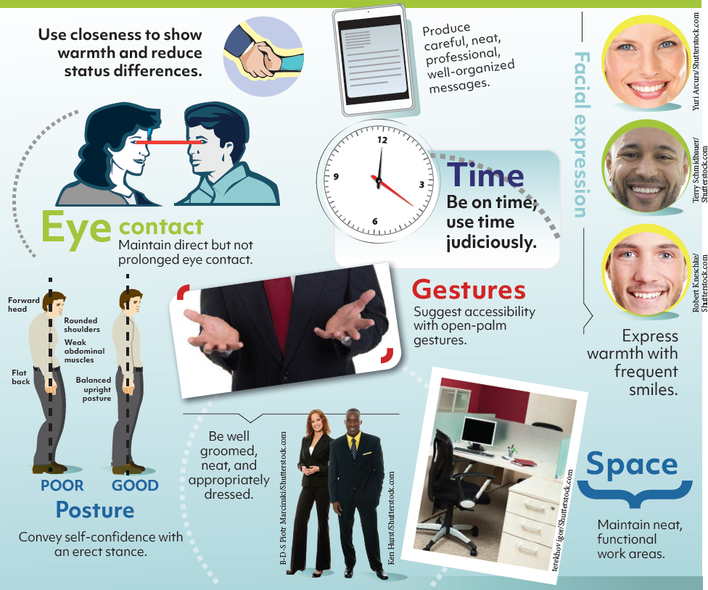
Figure 2.11 Sending Positive Nonverbal Signals in the Workplace
Notes:
Figure 2.11 illustrates tips for sending positive nonverbal signals in the workplace.
Building Strong Nonverbal Communication Skills in the Workplace:
Establish and maintain eye contact.
Use posture to show interest.
Reduce or eliminate physical barriers.
Improve your decoding skills.
Probe for more information.
Interpret nonverbal meanings in context.
Associate with people from diverse cultures.
Appreciate the power of appearance.
Observe yourself on video.
Enlist friends and family.

Slide 41
Learning Objective 2.5
Describe how developing professionalism and business etiquette skills can give you a competitive edge.

Slide 42
Developing Professionalism and Business Etiquette Skills On-Site and Online (1 of 3)
Professionalism* – desirable workplace behavior; being considerate, respectful, reliable, honest, prompt, well-groomed, and self-motivated
Business etiquette* – an attitude, a desire to show others consideration, courtesy, and respect
Understanding Professionalism and the Cost of Incivility
Absenteeism or tardiness can be grounds for dismissal.
Employees may sabotage their careers with unprofessional language.
Employees are more likely to be taken seriously and promoted if they maintain a professional image.

Slide 43
Figure 2.12 Projecting Professionalism When You Communicate (1 of 3)
Unprofessional |  | Professional
Uptalk, a singsong speech pattern, making sentences sound like questions; like used as a filler; go for said; slang; poor grammar and profanity. | Speech habits | Recognizing that your credibility can be seriously damaged by sounding uneducated, crude, or adolescent.
Sloppy messages with incomplete sentences, misspelled words, exclamation points, IM slang, and mindless chatter. E-mail addresses such as partyanimal@gmail.com, snugglykitty@icloud.com, or hotmama@outlook.com. | E-mail | Messages with subjects, verbs, and punctuation, free from IM abbreviations; messages that are concise and spelled correctly even when brief. E-mail addresses that include a name or a positive, businesslike expression.
Notes:
Figure 2.12 details seven areas you will want to review to be sure you are projecting professionalism:
Speech habits
E-mail
Internet
Voice mail
Telephone presence
Cell phones, tablets
Texting

Slide 44
Figure 2.12 Projecting Professionalism When You Communicate (2 of 3)
Unprofessional |  | Professional
Suggestive handles and user names that point to an immature, unhealthy lifestyle. Posts that reveal political, religious, and other personal leanings. | Internet, social media | Real name handles and user names that don’t sound cute or like chatroom nicknames. Posts in good taste, fit for public consumption.
An outgoing message with strident background music, weird sounds, or a joke message. | Voice mail | An outgoing message that states your name or phone number and provides instructions for leaving a message.
Soap operas, thunderous music, or a TV football game playing noisily in the background when you answer the phone. | Telephone presence | A quiet background when you answer the telephone, especially if you are expecting a prospective employer’s call.

Slide 45
Figure 2.12 Projecting Professionalism When You Communicate (3 of 3)
Unprofessional |  | Professional
Using electronics during business meetings for unrelated purposes or during conversations with fellow employees; raising your voice (cell yell); forcing others to overhear your calls. | Cell phones, tablets | Turning off phone and message notification, both audible and vibrate, during meetings; using your smart devices only for meeting-related purposes.
Sending and receiving text messages during meetings, allowing texting to interrupt face-to-face conversations, or texting when driving. | Texting | Sending appropriate business text messages only when necessary (perhaps when a cell phone call would disturb others).

Slide 46
Developing Professionalism and Business Etiquette Skills On-Site and Online (2 of 3)
Gaining an Etiquette Edge in a Networked World
Use these pointers to polish social competencies:
Use polite words. Be generous with words and phrases such as please, thank you, and you’re welcome.
Express sincere appreciation and praise. Tell coworkers verbally or in writing how much their efforts are appreciated.
Be selective in sharing personal information. Avoid talking about health concerns, personal relationships, or finances.
Don't put people down. A reputation for criticizing others will have coworkers wondering what is being said behind their backs.

Slide 47
Developing Professionalism and Business Etiquette Skills On-Site and Online (3 of 3)
Respect coworkers' space. Turn down the phone ringer and avoid strong-smelling food or perfume.
Rise above others' rudeness. Refuse to use profanity or participate in questionable joke-telling.
Be considerate when sharing space and equipment with others. Clean up when a task is complete.
Choose the high road in conflict. Keep a calm tone and focus on the work rather than on personality differences.
Disagree agreeably. Respect the opinions of others.

Slide 48
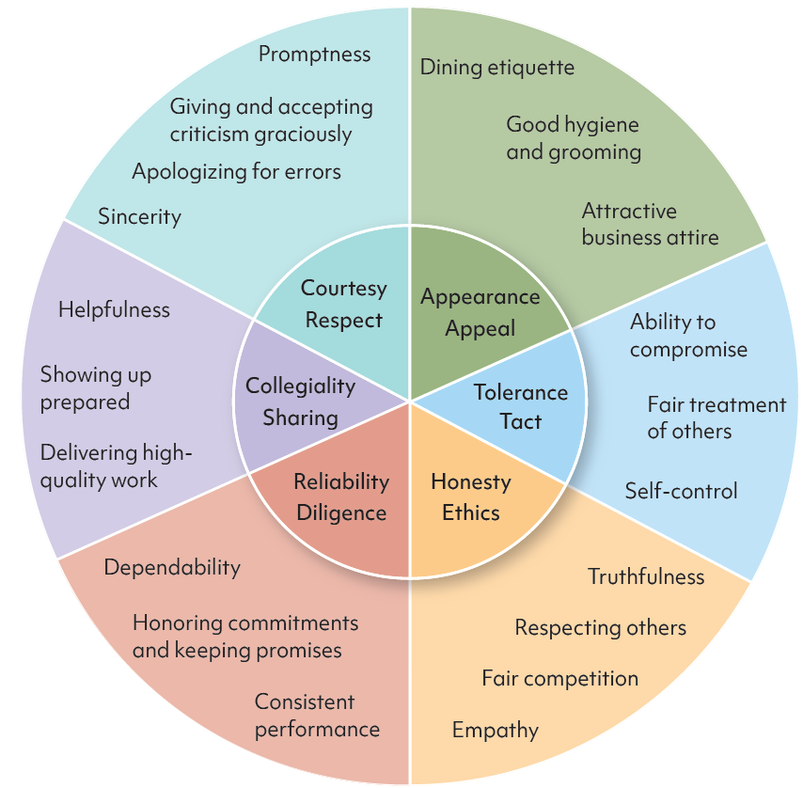
Figure 2.13 The Six Dimensions of Professional Behavior
Notes:
There are six main dimensions of professional behavior that will ease your entry into the world of work, as shown in Figure 2.13.

Slide 49
Summary
After reading this chapter, you should be able to:
Explain how you can contribute to successful team performance in the digital-age workplace.
Identify best practices for effective face-to-face and virtual meetings.
Name active listening skills.
Discuss how effective nonverbal communication can help you advance your career.
Describe how developing professionalism and business etiquette skills can give you a competitive edge.

